Slide 1
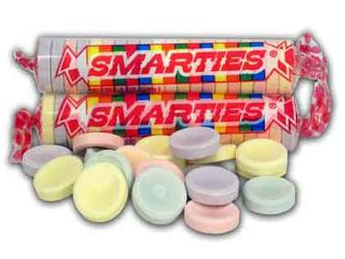
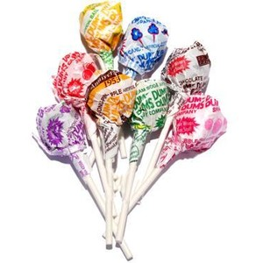
Are Smarties smarter than DumDums? An experimental study of intelligence
Adapted from:
Lewandowski, G. W. (2003) http://www.teachpsychscience.org/files/pdf/56201061709AM_1.PDF

Slide 2
Assignment of Participants to Conditions
Decide whether you are one of the “smarties” or one of the “dum dums” by taking the corresponding candy.
.

Slide 3
Intelligence Test
On a sheet of paper number 1 – 10. At the top of the page write down what condition you are in:
“I am one of the smarties”
or
“I am a dum dum”
I will read each question one time only.

Slide 4
Question 1
Is there a Fourth of July in England?

Slide 5
Question 1
Is there a Fourth of July in England?
YES

Slide 6
Question 2
How many birth days does the average man have?

Slide 7
Question 2
How many birth days does the average man have?
ONE

Slide 8
Question 3
How many months have 28 days?

Slide 9
Question 3
How many months have 28 days?
12 / all of them

Slide 10
Question 4
In baseball, how many outs are there in an inning?

Slide 11
Question 4
In baseball, how many outs are there in an inning?
6

Slide 12
Question 5
Is it legal in California for a man to marry his widow’s sister?

Slide 13
Question 5
Is it legal in California for a man to marry his widow’s sister?
No, the man is dead

Slide 14
Question 6
Divide 30 by ½ and add 10. What is the answer?

Slide 15
Question 6
Divide 30 by ½ and add 10. What is the answer?
70

Slide 16
Question 7
If there are 3 apples and you take away 2, how many do you have?

Slide 17
Question 7
If there are 3 apples and you take away 2, how many do you have?
2

Slide 18
Question 8
A farmer has 17 sheep and all but 9 die. How many are left?

Slide 19
Question 8
A farmer has 17 sheep and all but 9 die. How many are left?
9

Slide 20
Question 9
How many animals of each sex did Moses take on the ark?

Slide 21
Question 9
How many animals of each sex did Moses take on the ark?
None

Slide 22
Question 10
How many two-cent stamps are there in a dozen?

Slide 23
Question 10
How many two-cent stamps are there in a dozen?
12

Slide 24
While we are tabulating the results…
Review experimental design
Starting with the research question:
Do people who self-identify as “smarties” perform better on tests than people who self-identify as “dum dums”?

Slide 25
While we are tabulating the results…
Review experimental design
What was the dependent variable?

Slide 26
While we are tabulating the results…
Review experimental design
What was the dependent variable?
(What were we measuring?)

Slide 27
While we are tabulating the results…
Review experimental design
What was the independent variable?

Slide 28
While we are tabulating the results…
Review experimental design
What was the independent variable?
What were the levels of the independent variable?

Slide 29
While we are tabulating the results…
Review experimental design
Was the independent variable randomly assigned to participants?

Slide 30
What are the results?
What is your interpretation of the results?
Are other interpretations possible?

Slide 31
Key Concept in assessment of Intelligence: VALIDITY
What does the word valid mean?
Is this test a valid measure of intelligence? Why or why not?

