Slide 1
Performance Appraisal

Slide 2
Activity Set-Up
Get in groups of 6-8 people
Appoint a “manager” based on whose birthday is coming up soonest
Everyone else in the group will be the “subordinates”

Slide 3
Task Instructions
Subordinates’ task
Individually generate as many as possible novel uses for a brick (1 min)
Manager’s task
Rate each subordinate’s performance on a scale of 1-5 (1=poor, 5=excellent)
Subordinates who receive a score of 4 or 5 will get three pieces of candy
Share the results with each subordinate and distribute candy accordingly

Slide 4
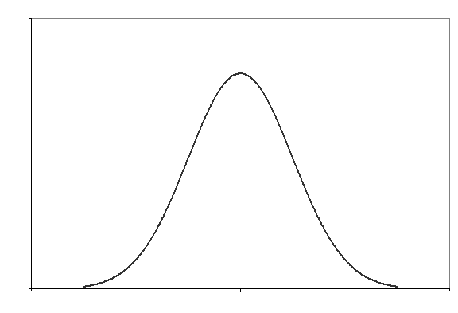
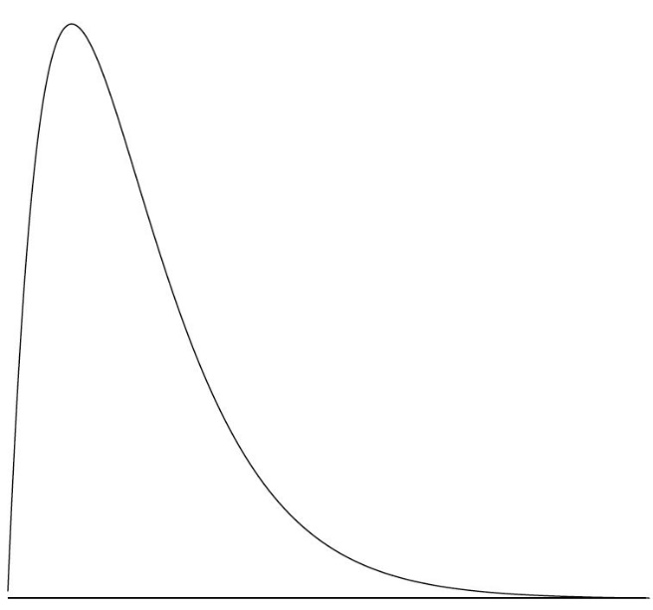
Which picture does your group’s scoring distribution most closely resemble?
Scoring Distributions
A
B
C
1 2 3 4 5
1 2 3 4 5
1 2 3 4 5

Slide 5
Discussion
Which one does your group’s rating distribution most closely resemble?
Why were the ratings skewed?
Why would this be problematic in an organization?
Do you think the results reflect what happens in “real life” (in organizations)?
How could the performance appraisal process be improved?
Notes:
When performance ratings are tied to outcomes (e.g., bonuses, promotions, etc.) managers often feel pressured to inflate ratings
Other reasons for rating inflation:
-Managers want to avoid confrontation / difficult conversations
-Managers want themselves and their team to look good
-Encourage and/or reward employees
-Don’t want to get stuck with bad performers
How did you feel…
-How fair did you think the rating process was?
-How fair did you perceive the outcomes to be?
-How did you feel about your score when everyone else also got a high score?
-Why would this be problematic in an organization? (morale issues, lose high performers, etc)
-If one team’s manager was a hard grader compared to the others… how does it feel to be on that team?
Improvements?
-Clear performance criteria
-Manager training for better consistency
-Ranking or forced distribution
-Comprehensive performance management system (multiple feedback conversations, build trust, set clear goals, etc.)

