Slide 1
Holland’s RIASEC Theory
Kajal and Nicolette

Slide 2
Holland’s RIASEC Theory
Organizes vocational interests into six summary categories
Aims to provide an awareness of what occupations an individual finds appealing and unappealing
Six Categories
Realistic
Investigative
Artistic
Social
Enterprising
Conventional

Slide 3
Example Occupations Based on RIASEC
Realistic: mechanic, pilot, engineer
Investigative: chemist, surgeon, statistician
Artistic: musician, writer, painter
Social: teacher, therapist, social worker, priest
Enterprising: salesperson, promoter, realtor
Conventional: accountant, analyst, administrator

Slide 4
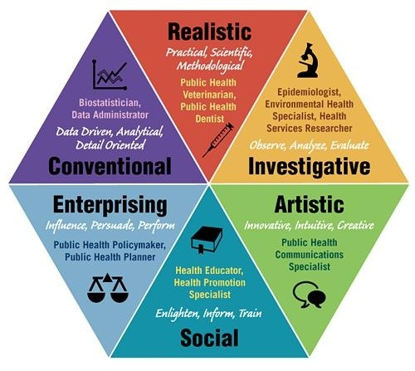
Which career pathway is for you?
Read each statement on your handout and fill in the circles to get your letters

Slide 5
How dissimilar or similar are your letters in relation to the rest of the class?

Slide 6
What do your letters mean?
These are Holland’s codes, and they are formed by rank-ordering the letters from highest to lowest response
Typically focus on three highest letters
What do they tell us?
People with similar codes show similar patterns of vocational preference and generally report better satisfaction and performance in similar occupational environments
Illustrates the importance of congruence between Holland’s codes for the person and the job in question
Predictor: degree of fit between a person’s code and the job code
Criterion: satisfaction, performance

