Slide 1

Adolescent Brain Science and Judicial Decisions

Slide 2


Important Cases
Atkins v. Virginia (2002)
Roper v. Simmons (2005)
Graham v. Florida (2010)

Slide 3
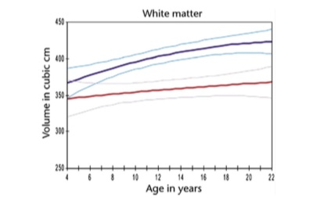
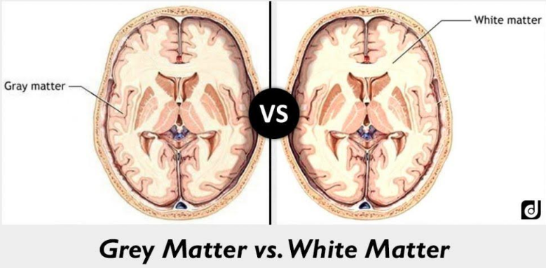
Two Main Components of the Brain: White Matter and Grey Matter

Slide 4
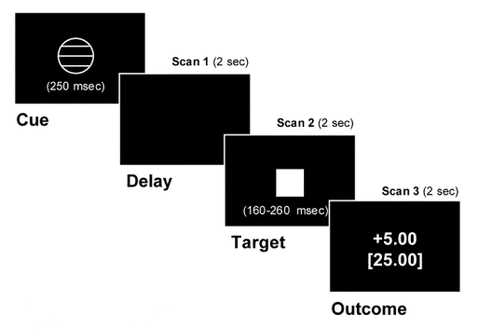
Neural Sensitivity to Absolute and Relative Anticipated Rewards in Adolescents
(Vaidya et al., 2003)

Slide 5
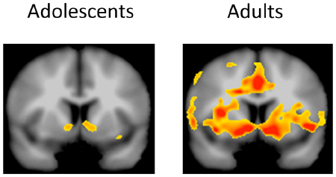
Age Differences in Whole Brain Activity
(Vaidya et al., 2003)

Slide 6
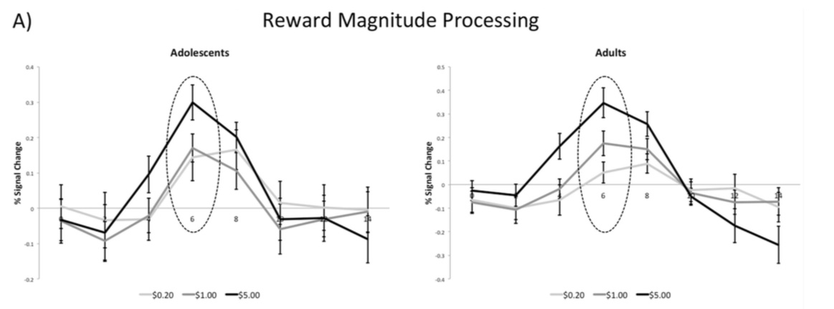
Age Differences in Ventral Striatum Activity
(Vaidya et al., 2003)

Slide 7
Implications of Adolescent Brain Development for Juvenile Justice

