Slide 1
Dementia and Considerations for Assessment
Cody D. Stitzel
Notes:
Hi everyone. Today’s class is going to focus on dementia and considerations for its assessment.

Slide 2
Overview
Dementia as a diagnosis
Importance of assessment
Use of standardized measures
Considerations for choosing measures
Commonly utilized measure
Notes:
Specifically, we’re going to learn about what dementia is as a diagnosis,
why it is important for clinicians to objectively assess whether an individual is developing dementia,
how standardized measures can be used to assess the extent of decline in functioning that has occurred.
We’re also going to discuss some of the considerations one should make when choosing which measure to use,
and lastly, a specific standardized measure that is commonly utilized in the assessment of dementia will be introduced.

Slide 3
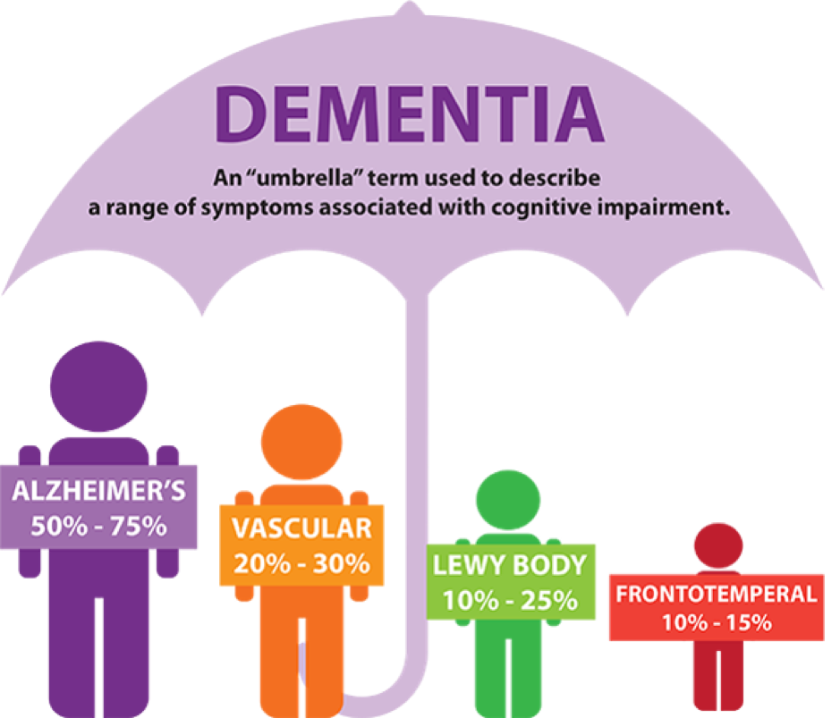
(Sheehan, 2012; http://www.dfwsheridan.org/types-dementia)
Notes:
To start, dementia is a clinical diagnosis, characterized by decline in cognition, and ability to care for oneself.
The term is often used to describe a for a wide range of symptoms that are associated with cognitive impairment; however, some sort of behavioral disturbance is typical, (**give example), which is what usually brings the issue to the attention of family members or health care providers.
The most common types of dementia include Alzheimer’s disease, Vascular dementia, Dementia with Lewy bodies, and frontotemporal dementia. And, you can see the breakdown here of the rough percentage of people with each.

Slide 4
Why Assess for Dementia?
Helps with decision making
Helps with differential diagnosis
Reduces subjectivity
Allows for comparisons
Monitoring change
Pinpoint specific deficits or declines
Cognitive vs. Functioning vs. Behavior vs. Quality of Life vs. Depression vs. Carer Burden vs. Overall Severity
(Sheehan, 2012)
Notes:
So why is it important to assess for dementia?
Well, it helps with decision making.
Each subtype of dementia is associated with its own specific deficits or areas of decline, and so, standardized assessment can help to make this differential diagnosis. Not only can assessment instruments help distinguish between different types of dementia, they can also help distinguish between dementia and natural age-related declines in functioning.
Using standardized assessments should also help reduce subjectivity on the part of the assessor,
and allows them to make comparisons of the client’s current functioning to that of other same-aged peers. (***Cultural disclaimer: That said, however, it’s always important for clinicians to take into account the client’s cultural, ethnic, and racial background, such that they are aware of the client’s English language abilities, their familiarity with Westernized tests, and the availability of appropriate norms to make comparisons).
Assessment is also helpful when we need to monitor change in clinical or controlled trials, or when deciding on treatment plans at specific time points in individuals’ lives.
Additionally, because dementia can have a wide variety of presentations, numerous measures have been designed that assess specific deficits or declines in functioning that are unique to the different subtypes of dementia.
For example, some measures assess for cognitive deficits, some assess adaptive functioning and one’s ability to preform daily living skills, some assess quality of life, etc.

Slide 5
Considerations When Choosing Measures
Referral question should guide decision
Diagnosis based on cognitive decline
Implies knowledge of premorbid functioning
Obtain a well-informed history
Records
Family interviews
Patient-facing vs. Informant test formats
(Groth-Marnat, 2009)
Notes:
Turning to considerations when choosing measures, first and foremost, the referral question always guide your decision of test selection.
So, if the referral question is asking about whether an individual meets criteria for dementia, cognitive decline is the major domain we are interested in, as that is what the DSM diagnostic criteria are based on.
However, the word decline implies that the individual’s functioning is worse than what it was at some point in the past, meaning knowledge of premorbid functioning is necessary.
With that said, you should obtain a well-informed history either from records or a close informant. As you can imagine, many clients with possible dementia may evidence problems with recall and may be unaware of the full extent of their deficits, and therefore it may be important to obtain family interviews and medical and mental health records.
Similarly, many of the dementia measures have different forms, where some involve direct assessment of the patient and others involve reports or surveys that are completed by informants or carers.

Slide 6
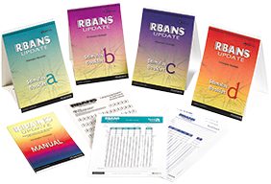
Repeatable Battery for the Assessment of Neuropsychological Status (RBANS)
Screening test
Ages (12) 20 – 89
Administration 20 – 25 minutes
Total score; 12 subtests
Commonly completed tasks
Parallel forms (4)
Spanish language versions
(Randolph, 1998, updated 2012; Groth-Marnat, 2009)
Notes:
Screening test, that was designed to identify and describe dementia, and can be administered to individuals ages 20 through 89, although there is also an updated supplement that goes all the way down to 12 years now.
Sensitive to early symptoms of dementia, and thus can accommodate younger individuals.
Administration of the test takes about 20- 25 minutes, which makes it realistic for use in clinical settings, unlike some of the other measures, which may be too lengthy.
It provides you with a total score, which are comprised from a combination of 12 subtests.
Subtests are commonly used tasks, such as having the participant learn lists of words, repeat details from a paragraph, and reproduce complex designs.
By having participants complete these various tasks, a wide-range of functioning can be assessed, so that patterns of scores obtained can be used to distinguish different types of impairments. For example, one individual may predominately suffer from memory impairment whereas another individual may suffer from problems with verbal fluency. Distinguishing which impairment is prominent can inform treatment efforts.
There are four parallel versions of the test, meaning four different versions that are of equal difficulty.
Having parallel forms of the test can reduce practice effects, and this is important as the test is designed to be re-administered at different time points. This is helpful for clients with dementia because it allows you to track decline and thus help with treatment planning and decision making.
In addition to the various forms, there is a Spanish language version available of the RBANS with validated norms, though this is unfortunately the only other language version available at this time.

Slide 7
Resources
Groth-Marnat, G. (2009). Handbook of psychological assessment, Fourth edition. G. Groth-Marnat. (Ed.). Hoboken, New Jersey.
Randolph, C., Tierney, M. C., Mohr, E., Chase, T. N. (1998). The Repeatable Battery for the Assessment of Neuropsychological Status (RBANS): Preliminary Clinical Validity. Journal of Clinical and Experimental Neuropsychology, 20, 310-319.
Sheehan, B. (2012). Assessment scales in dementia. Therapeutic Advances in Neurological Disorders, 5, 349–358.

