Slide 1
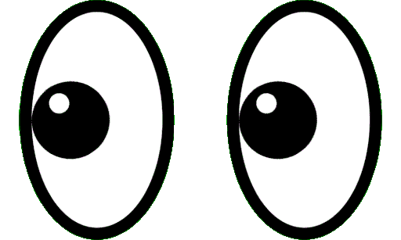
Intro to Psych: Week 5
Emotions & Mindfulness
Notes:
For scripts, activity description details, and supplemental questions, please see the full lesson plan

Slide 2
Warm- Up
Emotion Regulation
Wrap- Up
Goals
Emotions
Mindfulness
Overview

Slide 3
Today’s goals—
① Describe how valence and arousal can be used to interpret emotion states using the Circumplex Model of Affect.
② Differentiate emotion regulation strategies for managing emotions including the Process Model.
③ Gain insights into mindfulness and assess its relevance to your personal mental and physical well-being.

Slide 4
Warm- Up
Emotion Regulation
Wrap- Up
Goals
Emotions
Mindfulness
Mood Awareness & Mini-poll

Slide 5
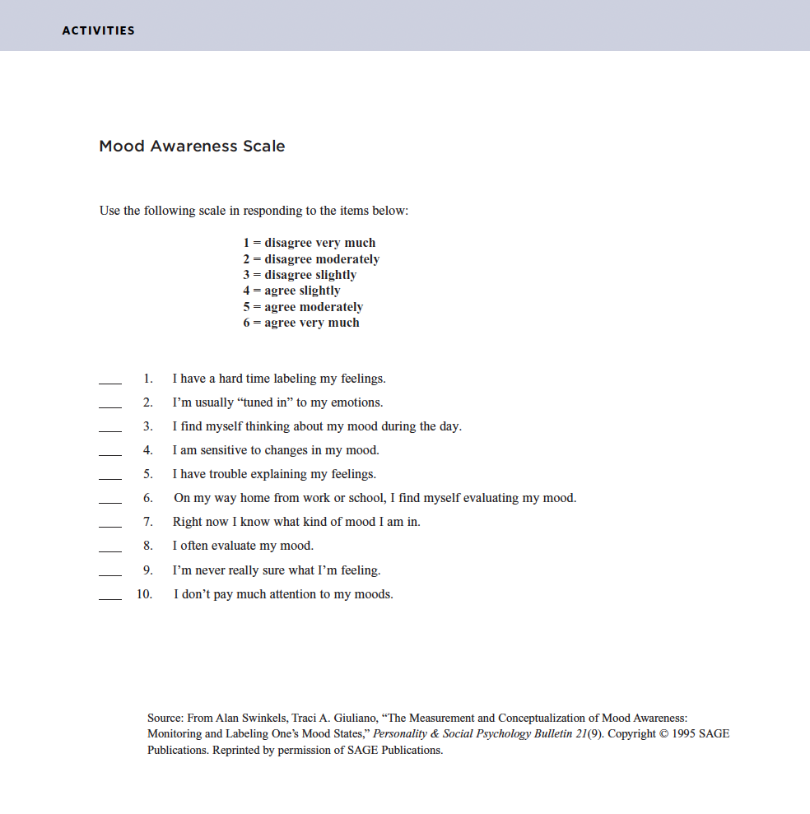
↓ Mood Awareness Scale ↓

Slide 6
Scoring the Mood Awareness Scale—
Mood Monitoring Subscale
Reverse your response to #10
1 = 6
2 = 5
3 = 4
4 = 3
5 = 2
6 = 1
Sum the values for items: #3, #4, #6, #8, & #10
Mood Labeling Subscale
Reverse your responses to #1, #5, #9
1 = 6
2 = 5
3 = 4
4 = 3
5 = 2
6 = 1
Sum the values for items: #1, #2, #5, #7, #9

Slide 7
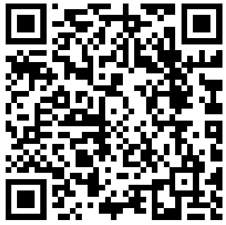
Scan the QR Code
or go to:
PollEv.com/ kailesmith025

Slide 8
Warm- Up
Emotion Regulation
Wrap- Up
Goals
Emotions
Mindfulness
Identifying & Mapping Emotions

Slide 9
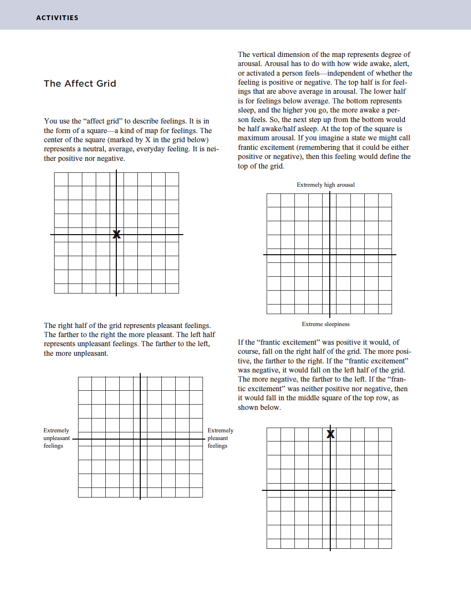
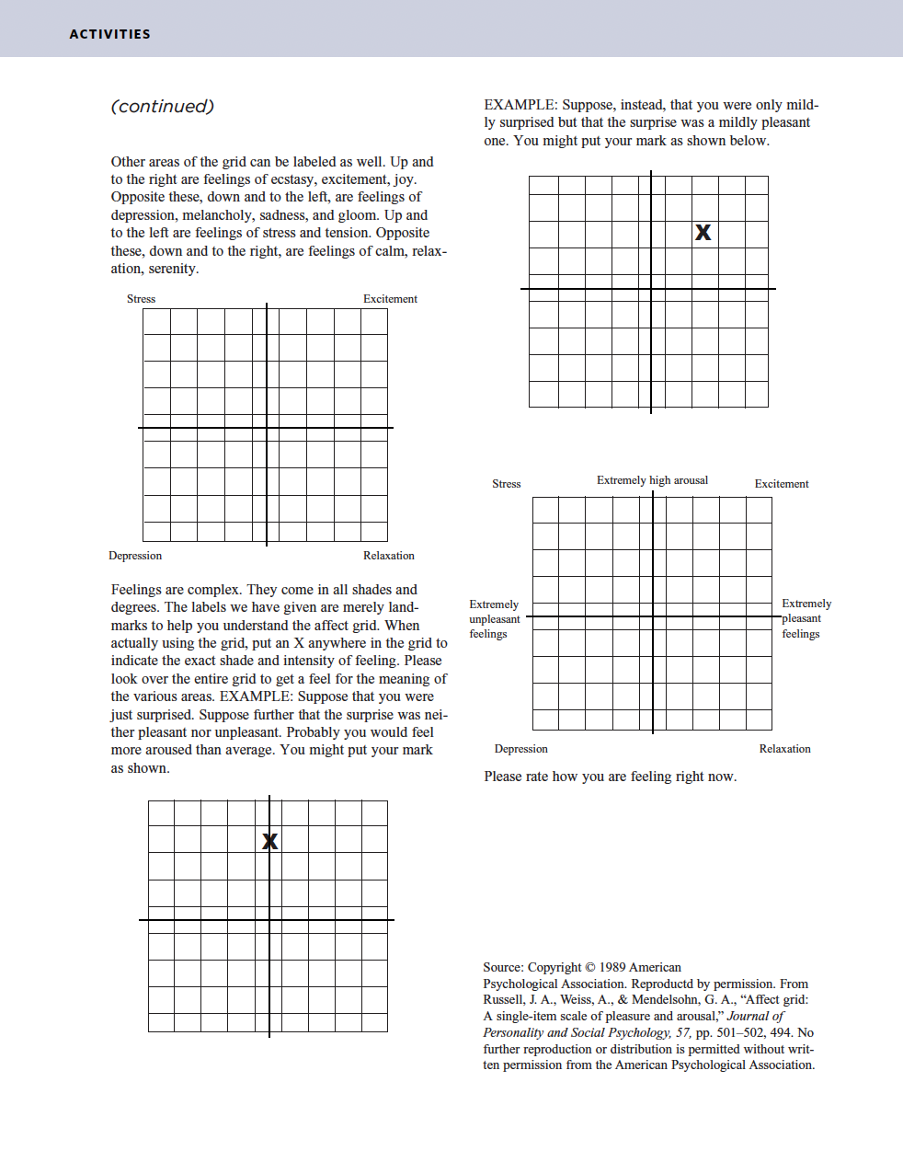
↓ Emotions Exercise ↓

Slide 10
Emotion Valence (NEGATIVE – POSITIVE)
Unpleasant
Feelings
Pleasant
Feelings
(Self-assessment manikin: Bradley, 1994)

Slide 11
Emotion Arousal (CALM – EXCITED)
Low
Arousal
High
Arousal
(Self-assessment manikin: Bradley, 1994)

Slide 12
High Arousal
Unpleasant
Feelings
Pleasant
Feelings
Low Arousal
(Affect grid: Russell et al., 1989; Self-assessment manikin: Bradley, 1994)

Slide 13
High Arousal
Unpleasant
Feelings
Pleasant
Feelings
Low Arousal
(Affect grid: Russell et al., 1989; Self-assessment manikin: Bradley, 1994)

Slide 14
High Arousal
Unpleasant
Feelings
Pleasant
Feelings
Low Arousal
(Affect grid: Russell et al., 1989; Self-assessment manikin: Bradley, 1994)

Slide 15
High Arousal
Unpleasant
Feelings
Pleasant
Feelings
Low Arousal
(Affect grid: Russell et al., 1989; Self-assessment manikin: Bradley, 1994)

Slide 16
High Arousal
Unpleasant
Feelings
Pleasant
Feelings
Low Arousal
(Affect grid: Russell et al., 1989; Self-assessment manikin: Bradley, 1994)

Slide 17
High Arousal
Unpleasant
Pleasant
Barrett & Russell (1998) Circumplex Model of Affect
Low Arousal

Slide 18
High Arousal
Unpleasant
Pleasant
Barrett & Russell (1998) Circumplex Model of Affect
Low Arousal

Slide 19
Small Group
Activity
→
Emotion
High Arousal
Emotion
Emotion
Emotion
Emotion
Emotion
Unpleasant
Pleasant
Emotion
Emotion
Emotion
Emotion
Emotion
Low Arousal

Slide 20
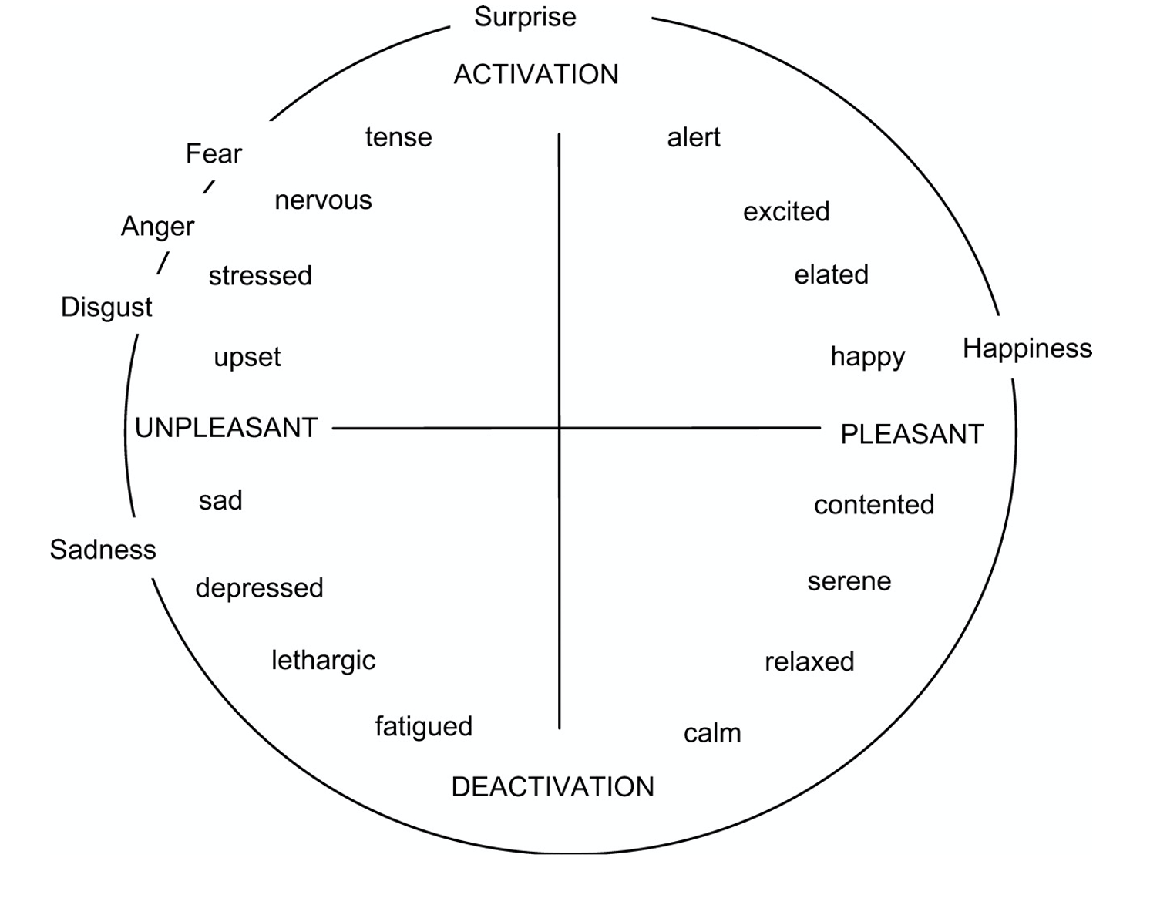
High Arousal
Unpleasant
Pleasant
Barrett & Russell (1998) Circumplex Model of Affect
Low Arousal

Slide 21
Warm- Up
Emotion Regulation
Wrap- Up
Goals
Emotions
Mindfulness
Emotion Regulation

Slide 22
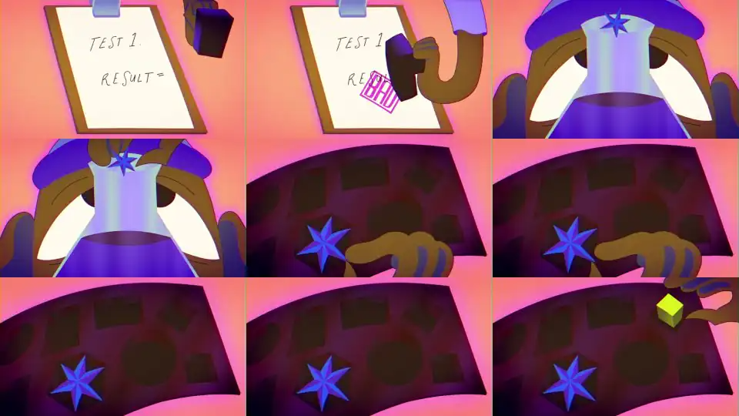
How to Manage Your Emotions—
🔗 https://www.youtube.com/watch?v=Uew5BbvmLks

Slide 23
Scan the QR Code
or go to:
PollEv.com/ kailesmith025

Slide 24
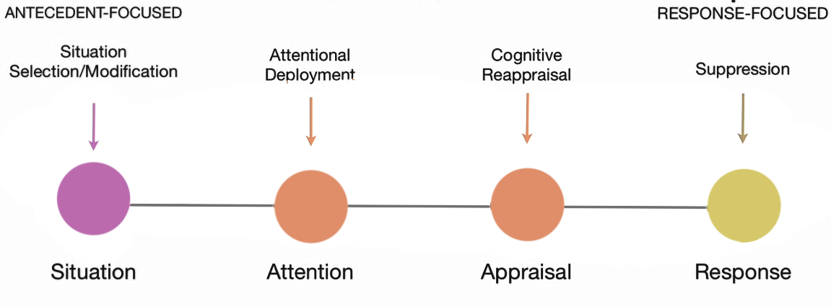
Process Model of Emotion Regulation—
Event/Stimulus
Assessment of Event
Response
Situation
Attention
Appraisal
Response
(Gross, 1998; Gross & Munoz, 1995)

Slide 25
What strategy do you find most effective for your own emotional regulation? —

Slide 26
Warm- Up
Emotion Regulation
Wrap- Up
Goals
Emotions
Mindfulness
Introduction to Mindfulness

Slide 27
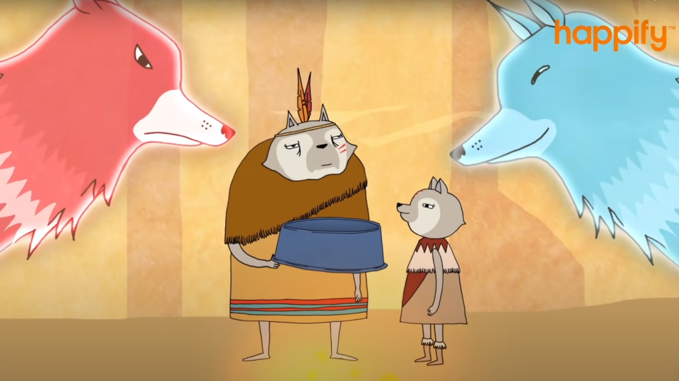
How Mindfulness Empowers Us—
🔗 https://www.youtube.com/watch?v=vzKryaN44ss

Slide 28
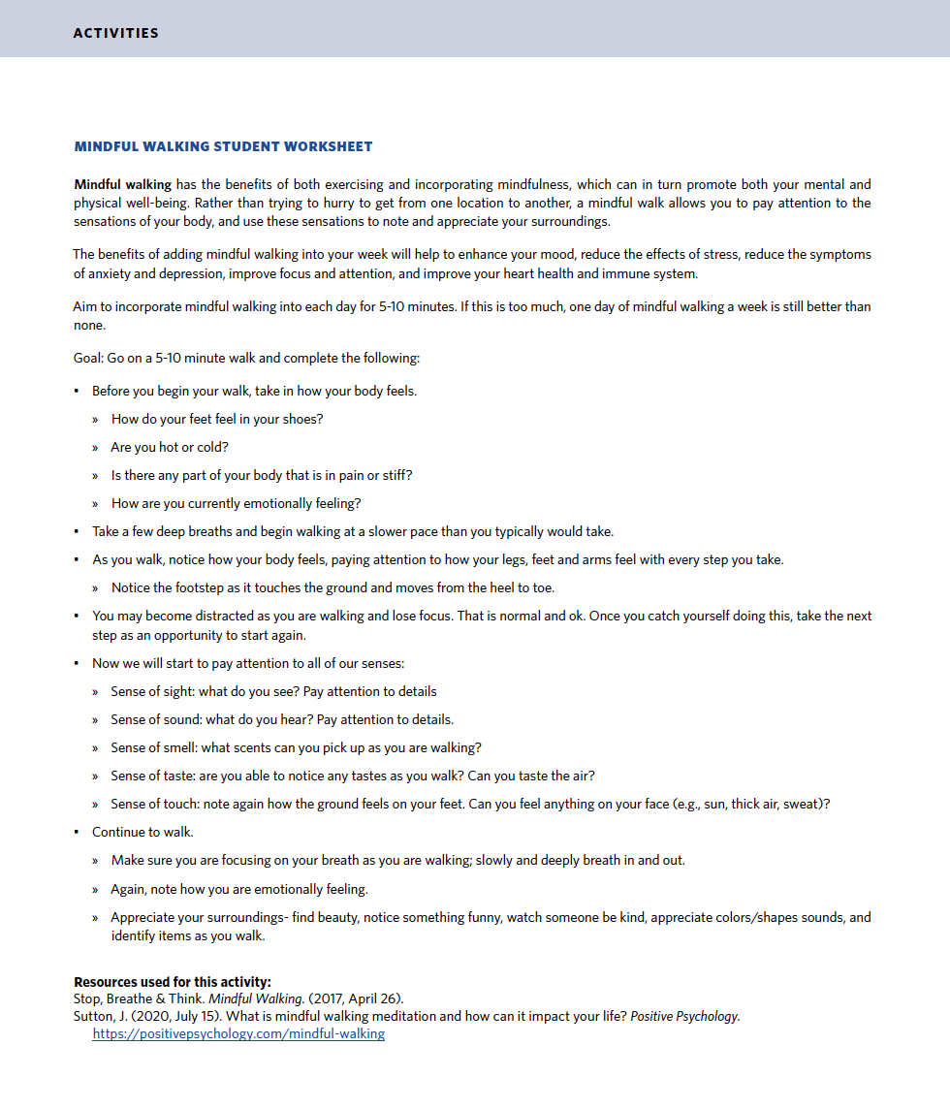
↓ Mindful Walking Activity ↓

Slide 29
Was there anything that stood out to you or anything new you noticed? How do you feel after? —

Slide 30
Warm- Up
Emotion Regulation
Wrap- Up
Goals
Emotions
Mindfulness
Wrap-up & Key Take-aways

Slide 31
Scan the QR Code
or go to:
PollEv.com/ kailesmith025

Slide 32
Up Next—
🌴 Wed, Oct 2 — NO CLASS [College Closed]
🍎 Qualtrics HW 4 [Due: Fri, Oct 4]
💗 Mon, Oct 7 — Love, Friendship, Social Support

Slide 33
✌️

